Slide 1
Seller Guidance
Content current as of February 2022
Live Events Solution Accelerator — Deliver the entire live stream event process in the cloud and on demand. Please note: The solution will be delivered as a custom engagement until it is ready for release as a managed service. Refer to the solution page in SharePoint for more information. The process flow descriptions on Slides #6 and #13 include an “Experience” phase. Customers typically own this phase, and it is out of scope for the standard engagement due to PII considerations. Please discuss with the solution team for details.
Deck outline
Business pitch
Market challenges – live stream events providers
Customer challenges
Microsoft solution overview & outcomes
Microsoft solution details (workflow)
Solution architecture
Video
Next steps/CTA
Demo
Technical pitch
Technical value
Availability
Process Flow details
Integration questions
Solution architecture
Next steps
Audience
Customer Experience Officer (CXO), broadcast teams, and marketing groups at:
Established M&E broadcast companies with existing workflows that will integrate with our solution
Marketing groups at organizations across all industries; may be relatively new to live event streaming (e.g., pop-up events)
Presenters
CSAs - Slides 3-9 deliver the business pitch and presenter notes
ALL - Slide 10 is a demo of the solution
SSPs - Slides 11-16 deliver the technical pitch and presenter notes. Some slides are duplicative of the Business Pitch section, with additional details for technical audience.
For internal use only. Delete this slide before presenting.
Notes:
Seller Guidance – for internal reference only, please delete this page before sharing externally

Slide 2
Live Events Solution Accelerator
Notes:
Thanks for your time today. I’m excited to talk with you about how the Live Events Solution Accelerator can help managed service providers deliver the entire live stream process in the cloud and on demand.
We’ll start by walking through the business case for the Solution Accelerator to explore
The industry context and common challenges in your market.
Specific barriers to innovation that you may be facing right now, and the outcomes you want to achieve
How the Solution Accelerator can help – what it is, the value it provides, and a simple overview of how it works.
And we’ll get a little bit into the technical details, which include
A technical value statement that describes the benefits from an implementation perspective.
A more detailed look at what is involved in the workflow, and
What steps we would take to get you started.

Slide 3
Live stream content is now integral to the event experience
Media and entertainment companies need efficient streaming solutions and audience insights
Increased demand for live stream events is here to stay.
17 million people watched Bud Light Seltzer’s New Year’s Eve 2020-2021 show.¹
56% of U.S. and U.K. live streamers plan to consume live video after the coronavirus pandemic.²
Compelling live stream content is critical to audience retention.
82% of consumers prefer live video from a brand over standard social media content.³
77% of executives struggle to gain timely data insights (such as viewer demographics or view duration) that could help optimize user experiences.⁴
Social responsibility is playing a growing role in brand reputation.
88% of people would like brands to help enable them be more environmentally friendly and ethical.⁵
15% of people experience a disability, which may limit their ability to attend an event in person.⁶
1. "The Livestream Show Will Go On. How COVID Has Changed Live Music—Forever" - TIME, March 2021
2. "Coronavirus Research | Series 4: Media Consumption and Sport" - GWI, April 2020
3. "Live Video Stats: What Consumers Want" - Vimeo Livestream, 2017
4. "Cookie-less targeting: What it is and how it applies to advertising" - IBM, May 2021
5. "88% Of Consumers Want You To Help Them Make A Difference" - Forbes, November 2018
6. Disability Inclusion - The World Bank
Notes:
M&E market challenges
The Covid-19 pandemic has accelerated demand for digital experiences that both broadcast and supplement live events.
For example: 17 million people tuned in to watch Bud Light Seltzer’s New Year’s Eve 2020-2021 show online, and surveys indicate that many still plan to consume live video after pandemic restrictions have lifted.
Compelling live stream content is increasingly critical to retaining audiences, with the vast majority of consumers now preferring live video from a brand over standard social media posts. Yet, even with the growing importance of delivering quality content, most organizations struggle to gain timely insights from user data – such as where the “geographic hot spots” are for high concentrations of viewers, to improve ad targeting. Or, viewing times for content – to pinpoint where viewers may be losing interest and dropping off. Getting this sort of information from your data can help you to discern where and how to shift your content strategy to create even better experiences.
Also, social responsibility is playing a growing role in brand reputation. Issues of sustainability and equity are increasingly influential to consumer decisions. Audiences want to engage with brands that are actively working toward more environmentally friendly and ethical experiences.

Slide 4
Challenges to creating valuable, engaging digital experiences
Delivery of live event streaming is complex due to the need for multiple vendors and navigating onsite logistics and COVID-19 restrictions.
High operating costs require up-front investments that create a barrier to entry for many and add pressure to deliver ROI.
Data and analytics are limited, and companies struggle to gain timely, valuable insights around consumer brand affinity.
Data security and protection of content are critical to maintain, and breaches are an inherent risk.
Advertising and other monetization tactics can be challenging to seamlessly integrate and personalize, leading to poor experiences that erode trust in the brand.
Notes:
Customer challenges
Complexity:
Hosting connected events is complex. There are multiple pieces, on the ground as well as virtually, to coordinate. Multiple vendors must be hired and managed. Operations need to pivot for changes in regulation, attendance, even weather. COVID-19 requirements affect travel, crowd size, types of events, locations, and more factors—and as of December 2021 the requirements and advice are changing, and many locales, and most countries, and even some states, have different rules about who can appear where and how.
High costs:
Existing producers face high operating costs to live stream events and for prospective new producers, the cost of entry is prohibitive: How can organizations enter this space without a massive investment in people and physical infrastructure?
Lack of audience insights:
Event producers don't feel they have enough information to cultivate and satisfy existing audiences or the right information to seek and connect with potential new customers/audience members. They also don't have real-time analytics about when people join or leave an event, where they're joining from, and any other behaviors that could help them tailor the experience better.
Identity and security: content and data need to be protected, for you and also for your audience.
Need for new monetization opportunities:
Producers must continually find new ways to monetize their events with advertising and subscriptions, but it can be challenging to seamlessly integrate and personalize content.

Slide 5
An on-demand solution for virtual live events
Live Events Solution Accelerator delivers simple live event streaming in the cloud
Simplify operations and reduce costs
The Live Events Solution Accelerator leverages proven technology on demand and in the cloud for live stream event content.
Additionally, Azure Synapse Analytics and Dynamics 365 Customer Insights gather rich analytics for event measurement and content optimization in a secure environment.
Enhance monetization opportunities
Gain robust analytics for meaningful insights
Maintain privacy and data security
Go greener with the Microsoft cloud
Notes:
Microsoft solution overview + outcomes
The Live Events Solution Accelerator moves the entire live stream process offsite and into the cloud, essentially virtualizing the onsite production truck to enable remote teams to work together in real-time for production of compelling experiences. It provides a simple template for a managed service provider to deliver live event streaming from anywhere in the world: a live concert, football match, esports event, or pop-up event can be
filmed in Australia,
edited in Paris,
emceed through Microsoft Teams in LA, and
delivered in real-time worldwide.
The solution runs on Azure with Azure Synapse Analytics and Dynamics 365 Customer Insights to deliver rich analytics for event measurement and feedback in a secure environment. It helps you to:
Simplify operations, by eliminating the need to coordinate multiple vendors and integrating with existing commercial platforms and preferred solution providers.
Reduce operating costs, by enabling producers to work from anywhere. The solution is available on-demand and scales to meet the unique needs of each event. Deliver a built-in personalized ad experience to known users.
Gain valuable insights around consumer brand affinity, to help your business create increasingly compelling experiences that engage and retain consumers.
Maintain data security
Audience identity and data are protected in the Microsoft cloud.
Go greener with the Microsoft cloud
Fewer onsite staff reduces carbon footprint.
Microsoft cloud sustainability initiatives support customers on the path to net zero.

Slide 6
Seamless live event experience delivery
Leverage our partners and integrate with existing solution providers and players
Ingest
Produce
Prepare
Distribute
Experience
Content is captured at the event and delivered to the cloud.
Production switching is orchestrated in the cloud from anywhere. Can include content from multiple sources e.g., commentary via Microsoft Teams.
Content is packaged and encoded for delivery to multiple endpoints. Includes ad insertion. Known users are served personalized content and ads.
The content is delivered to a CDN or a specific endpoint e.g., broadcast workflow, Microsoft Teams, or social channels.
Audiences have an engaging and seamless near real-time experience.
Analytics
Identity and security
Notes:
Solution detail: process flow
The Solution Accelerator focuses on the Ingest, Production, Preparation, and Distribution of live streaming event content, integrating with your existing platforms and players for the user experience.
The entire process of capturing and live-streaming an event is based on proven technology from Microsoft partners MediaKind, Evertz Microsystems, and Lumen that we’ve enabled to work in the cloud. These are industrial strength tools being brought together in this configuration for the first time. A little bit about each of our partners:
MediaKind’s end-to-end video delivery solutions include Emmy award-winning video compression solutions for contribution and direct-to-consumer video service distribution, advertising and content personalization solutions, high efficiency cloud DVR, and TV and video delivery platforms. Evertz is a leading global manufacturer of broadcast equipment and solutions that deliver content to television sets, on-demand services, WebTV, IPTV, and mobile devices.
Lumen is a Fortune 500 company offering communications, network services, security, cloud solutions, voice, and managed services to help change how people interact and how companies acquire, analyze, and act on data with flexible, intelligent, secure, and collaborative solutions built for the next generation of business.
The live stream delivery process starts with Ingestion by MediaKind. MediaKind has connections to over 240 stadiums worldwide. Its solution captures the live content and the event and encodes and uploads feeds to the Evertz production platform in Azure. Production
Evertz enables producers to mix the raw feeds in its virtual production studio (BRAVO studio). It has a user-friendly interface for live-switching between many cameras, sweetening audio, adding graphics, and more.
Preparation The broadcast feed is delivered to the Aquila streaming as a service solution from MediaKind to set up channels for delivery. MediaKind packages and encodes the content for delivery across multiple endpoints. Ad insertion is also included in this part of the process, best suited for generic ads that can address the broad audiences. Distribution:
Lumen provides the built-in Content Delivery Network to distribute content to any platform by replicating the signal to bring it closer to each user for seamless streaming. You can integrate it with existing players for distribution or spin up a new dedicated channel for the event.
Experience:
While Experience is generally out of scope for this solution, we can discuss your options if you need user experience support.
As part of the audience experience, MediaKind can include personalized ad insertion for known users—including tailored ads and campaigns for better monetization of advertising.
Throughout the entire process, the solution is
Delivering rich analytics for audience insights and content optimization, and
Protecting content and data in the Microsoft Cloud.

Slide 7
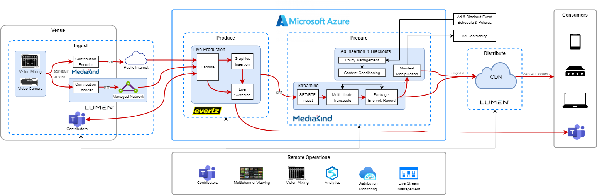
Architecture

Slide 8
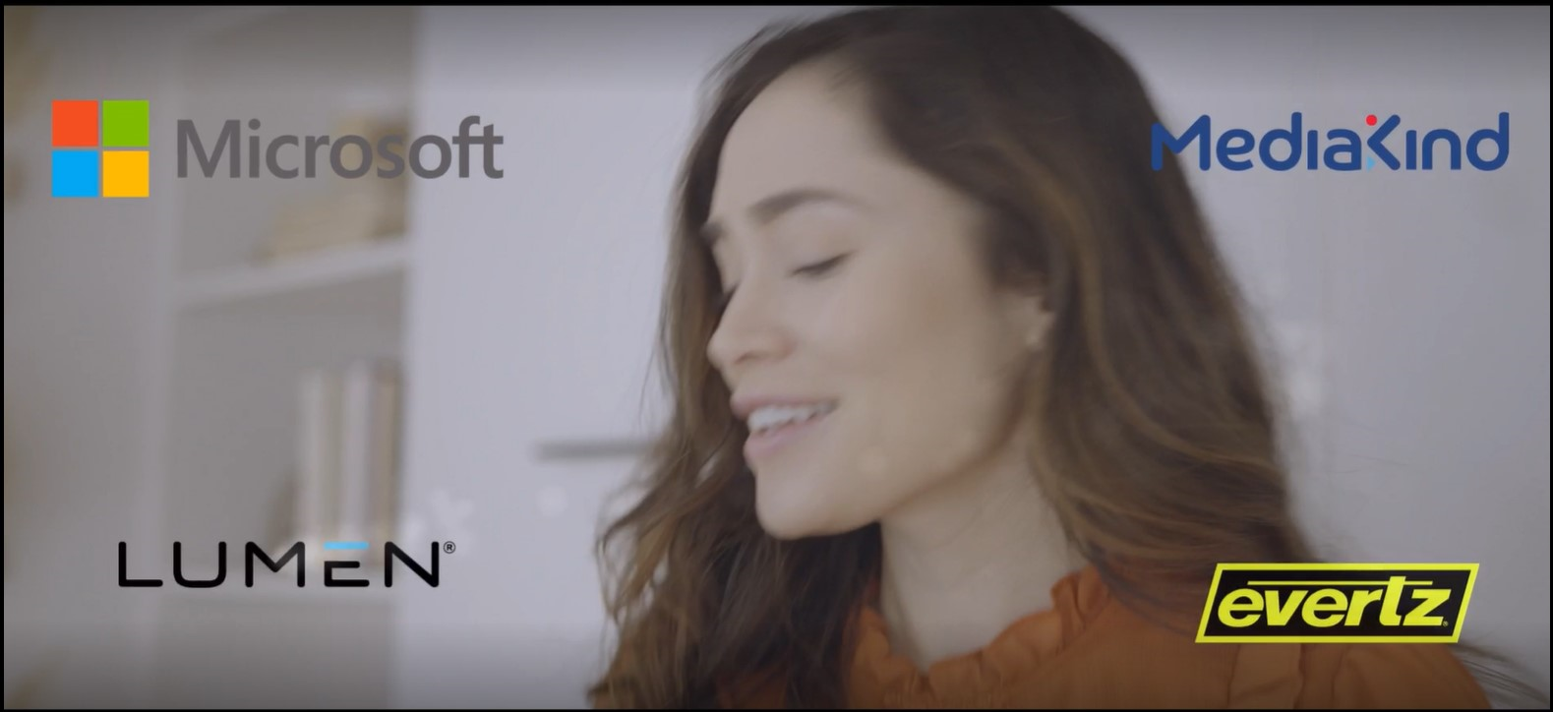
An unprecedented partnership to revolutionize live events
A team – please drop a link to the final video HERE and IN THE EMAIL. Thanks!
Watch the Live Events Solution Accelerator video >
Notes:
Solution overview video

Slide 9
Next steps
Plan the event
Prepare for the event
Deliver the event
Define event details including location, offsite requirements, connectivity, technical resources, endpoints, and the detailed event plan.
Connect event location to Microsoft Azure, prepare delivery endpoints, deploy additional integrations and solutions, upload supporting media, and train the team.
Run pre-event testing and monitor the live event.
4 hours
2-3 days
2-5 weeks
Notes:
Customer Journey/CTA

Slide 10
Demo
A team – please drop in a screen capture and link to the final demo
Insert screenshot of demo
Watch the Live Events Solution Accelerator demo >

Slide 11



Pre-built, customizable solution for live event streaming
Live Events Solution Accelerator delivers simple live event streaming in the cloud
Configure multiple delivery endpoints
No need to code an integration or use custom applications.
Built-in monitoring
Ensure quality of service for the entire experience.
Minimal management
A single team manages the entire process instead of multiple disparate teams.
Scalable
Available on demand to grow events without added complexity or cost.
Notes:
Technical value pitch - Talk track in progress Simplicity of execution – you can configure multiple endpoints, no need to code an integration. No bespoke applications needed.
Quality of service monitoring is built-in.
Deployment will be automated through the managed service – it will be invisible to the customer
Operational support – one team to manage the entire event. Makes technical users life a lot easier.
Scale – you can take on a bigger event. Scale is horizontal and vertical: any size event, and also any Azure region globally

Slide 12
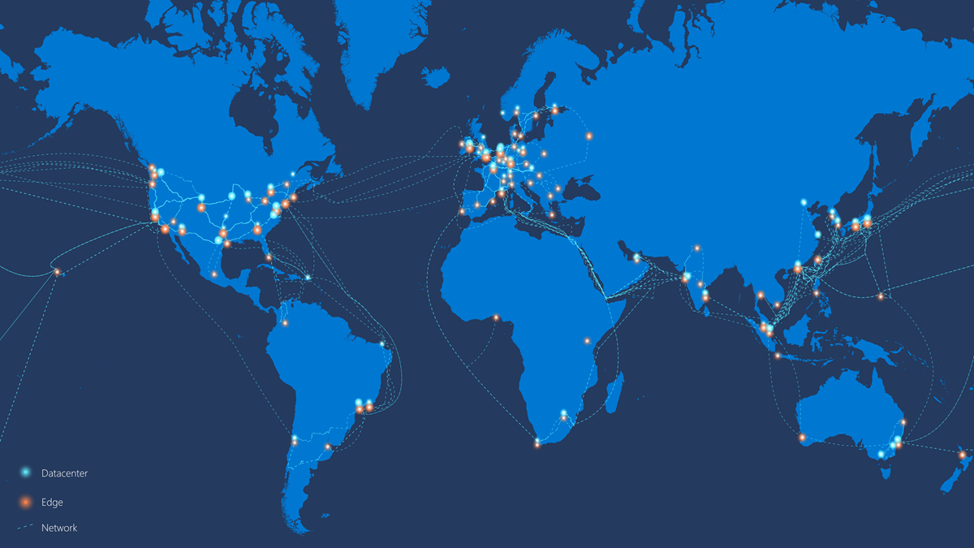
Azure regions with availability zones
Azure provides the most extensive global footprint of any cloud provider and is rapidly opening new regions and availability zones.
As of January 2022:
Americas | Europe | Africa | Asia Pacific
Brazil South | France Central | South Africa North | Australia East
Canada Central | Germany West Central |  | Central India
Central US | North Europe |  | Japan East
East US | Norway East |  | Korea Central
East US 2 | UK South |  | Southeast Asia
South Central US | West Europe |  | East Asia
US Gov Virginia | Sweden Central
West US 2
West US 3
Source: Microsoft global network Jan 2021
Notes:
Microsoft’s Azure Cloud provides the compute, storage, networking, and data to power the Live Events Solution Accelerator.
It has the largest geographical footprint of any cloud provider today with over 60 regions, 200 datacenters, and 4 million servers worldwide.
For resiliency, regions are comprised of availability zones which are data centers geographically close to one another that have been designed to have no single point of failure. Further, our services such as data and compute contain built-in resiliency orchestration services thereby simplifying this from the application provider.

Slide 13
Seamless live event experience delivery
Leverage our partners and integrate with existing solution providers and players
Ingest
Produce
Prepare
Distribute
Experience
Content is captured at the event and delivered to the cloud.
Ingest process supports both produced feeds and cameras as sources for SRT streams.
Production switching is orchestrated in the cloud from anywhere. Includes content from multiple sources e.g., Microsoft Teams.
Visualization of inputs and preview outputs and multi-channel audio mixer are available.
Content is packaged and encoded for delivery to multiple endpoints. Includes ad insertion. Known users are served personalized content and ads.
Streaming-as-a-Service reduces costs and provides a high-quality, low latency experience.
The event is delivered to a CDN or other endpoint such as a broadcast workflow, Microsoft Teams, or social channels.
Our CDN provides global delivery for best-in-class streaming experiences.
Audiences have an engaging and seamless near real-time experience.
Integrate with your existing platform and players or stand up a new dedicated platform.
Analytics
Identity and security
Notes:
Solution detail: process flow (added Technical detail) The Solution Accelerator focuses on the Ingest, Production, Preparation, and Distribution of live streaming event content, integrating with your existing platforms and players for the user experience.
The entire process of capturing and live-streaming an event is based on proven technology from Microsoft partners MediaKind, Evertz Microsystems, and Lumen that we’ve enabled to work in the cloud. These are industrial strength tools being brought together in this configuration for the first time. A little bit about each of our partners:
MediaKind’s end-to-end video delivery solutions include Emmy award-winning video compression solutions for contribution and direct-to-consumer video service distribution, advertising and content personalization solutions, high efficiency cloud DVR, and TV and video delivery platforms. Evertz is a leading global manufacturer of broadcast equipment and solutions that deliver content to television sets, on-demand services, WebTV, IPTV, and mobile devices.
Lumen is a Fortune 500 company offering communications, network services, security, cloud solutions, voice, and managed services to help change how people interact and how companies acquire, analyze and act on data with flexible, intelligent, secure and collaborative solutions built for the next generation of business.
Ingestion
The live stream delivery process starts with Ingestion by MediaKind. MediaKind has connections to over 240 stadiums worldwide. Its solution captures the live content and the event and encodes and uploads feeds to the Evertz production platform in Azure. The ingest process supports both produced feeds and cameras as acquisition sources with on-site encoders to capture these sources into SRT streams. To ensure low-latency, a contribution network is used between the event location and cloud facility. A production studio sits within the cloud serving as a full virtual studio. In addition, this solution supports video conferencing as an additional source for the production studio.
Production
Evertz enables producers to mix the raw feeds in its virtual production studio (BRAVO studio). It has a user-friendly interface for live-switching between many cameras, sweetening audio, adding graphics, and more. BRAVO Studios captures and records all the inputs that are used in the production. This includes the remote camera feeds coming using SRT (Secure Reliable Transport) and Microsoft Teams streams. It provides full video switching where inputs are visualized as is the program preview outputs. In addition to the video mixing, BRAVO Studio offers a multi-channel audio mixer.
Preparation The produced stream from Evertz BRAVO Studio is ingested into the platform over the Azure Virtual Network, or Internet, using SRT which adds a layer of security and reliability with low latency.
Once ingested, the content is transcoded into multiple bitrates and packaged into adaptive bitrate formats suitable for delivery over a Content Delivery Network and playback by the audience on browsers, mobiles, tablets, smart TVs, and streaming devices.
The stream can also be sent to a Microsoft Teams Live Event where you may want to support a watch party or for inclusion in a meeting or presentation. In addition to transcoding and packaging content for streaming, high value content can also be encrypted. The encryption is performed based on keys received from a DRM platform, which can be provided by MediaKind as a part of our larger Direct To Consumer offering, or by a 3rd party platform. We’ve integrated with several of the most popular 3rd party DRM platforms and support the CPIX standard. Distribution:
Lumen provides the built-in Content Delivery Network to distribute content to any platform by replicating the signal to bring it closer to each user for seamless streaming. You can integrate it with existing players for distribution or spin up a new dedicated channel for the event. The Lumen Content Delivery Network provides OTT (over the top) streaming capabilities to online viewers leveraging our global IP network backbone and strong ISP peering relationships designed to deliver best-in-class streaming experiences. One of the largest CDNs in the world, the Lumen CDN is architected for high-availability and low latency, with security features that include encrypted delivery over the network and active monitoring to mitigate security threats.
Additionally, Lumen’s CDN can be augmented with our peer-assisted Mesh Delivery technology to improve quality of service, increase reach, and enable reliable scaling for flash crowds during high traffic events.
Experience:
The solution can integrate with your existing commercial platform for experience delivery, or you can use it to stand up a dedicated platform for the event. As part of the audience experience, MediaKind can include personalized ad insertion for known users—including tailored ads and campaigns for better monetization of advertising.
Throughout the entire process, the solution is
Delivering rich analytics for audience insights and content optimization
Protecting identity and ensuring security in the Microsoft Cloud.

Slide 14
Flexible integration with your existing environment
Solution works seamlessly with established platforms and systems, delivers to multiple endpoints
Questions to determine how best to integrate with your environment:
Where are event staff and content contributors located? e.g., Director, commentators
Will you be bringing on-premises hardware? e.g., cameras, encoders
Which CDN providers do you work with?
What are your delivery endpoints? Where is this event going out to?
Which ad service do you use?
Notes:
Flexible integration The Solution Accelerator is flexible and can integrate seamlessly with your existing environment; for example, if you already have the infrastructure for signal capture, a subscription management system, or a universal data platform, the solution can integrate with any or all of these.
When your service provider starts planning with you, they’ll be asking a number of questions to understand your existing environment and determine the best approach to integration. For example they’ll want to know whether you will you be bringing on-prem hardware, what ad service you use, who your current CDN provider is, and so on.

Slide 15
Architecture

Slide 16
Next steps
Plan the event
Prepare for the event
Deliver the event
Define event details including location, offsite requirements, connectivity, technical resources, endpoints, and the detailed event plan.
Connect event location to Microsoft Azure, prepare delivery endpoints, deploy additional integrations and solutions, upload supporting media, and train the team.
Run pre-event testing and monitor the live event.
4 hours
2-3 days
2-5 weeks
Notes:
Customer Journey/CTA

Slide 17
Thank you

